Slide 1
ITM – Mechatronic engineering Control systems in robotics ON/OFF control system for single axis arm John Isaac Junior Huertas Montes Jorge Torres Arboleda

Slide 2
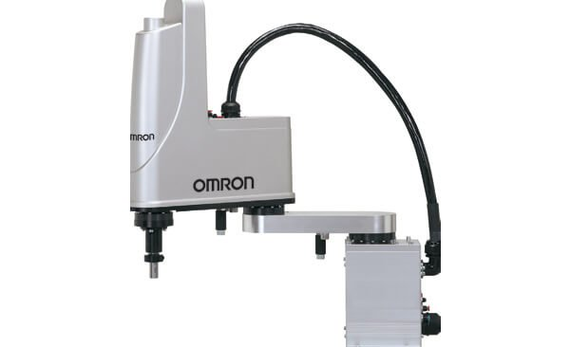
Content
Joint requirements
Calculations to actuators selection
Transmission selection
Sensors selection
Electronic design
Control design
Mechanic design
POR system
SOR system
Figure 1. OMRON SCARA robot as design reference

Slide 3
1. Joint requirements
For this practice, we choose a joint based on a SCARA type robot, typically named E2 element, our joint has a rotational movement, with the next requirements:
Design requirements
Movement type | Rotational
Payload | 110 g
Movement range | 180 °
Maximum speed | 50 RPM
Joint length | 12 cm
Figure 2. OMRON SCARA robot as design reference
Table 1.Design requirements

Slide 4
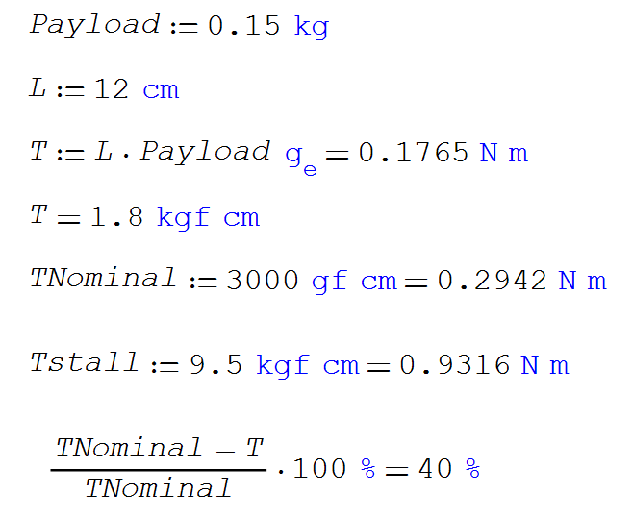
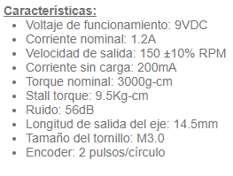
2. Calculation to actuators selection
16 pulses per revolution
2 quadrature channels

Slide 5
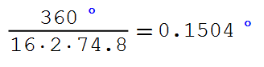
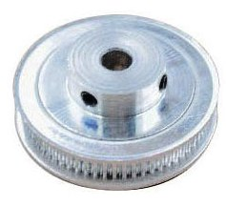
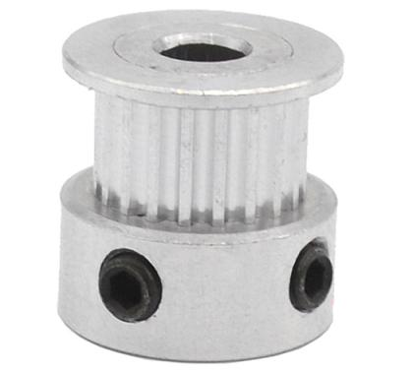
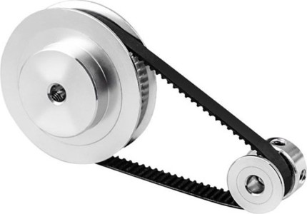
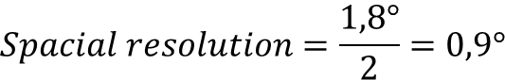

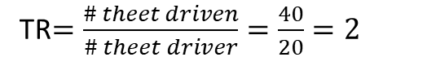
3. Transmission selection
Given the motor torque, and the design requirements, the proposed transmission was:
$$Transmission ratio=2:1$$
TR$=\frac{\# theet driven}{\# theet driver}=\frac{40}{20}=2$
$$Spacial resolution=\frac{1,8°}{2}=0,9°$$
In order to reach the transmission ratio, a simple gear system was chosen with:
Figure 5. timing pulley 16 teeth
Figure 6. timing pulley 60 teeth
Figure 4. GT2 transmission example

Slide 6
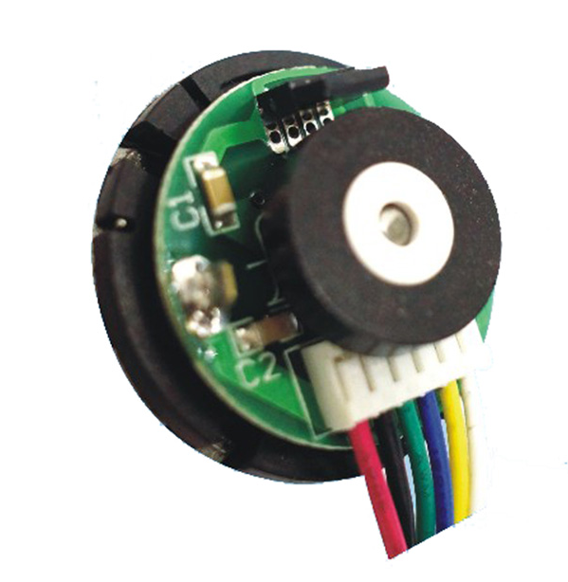
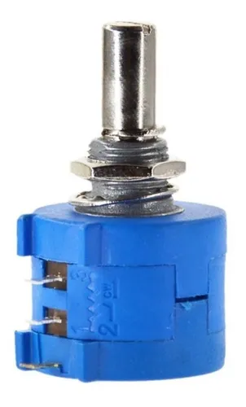
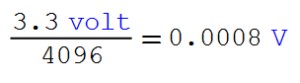

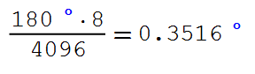
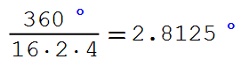
4. Sensors selection

Slide 7
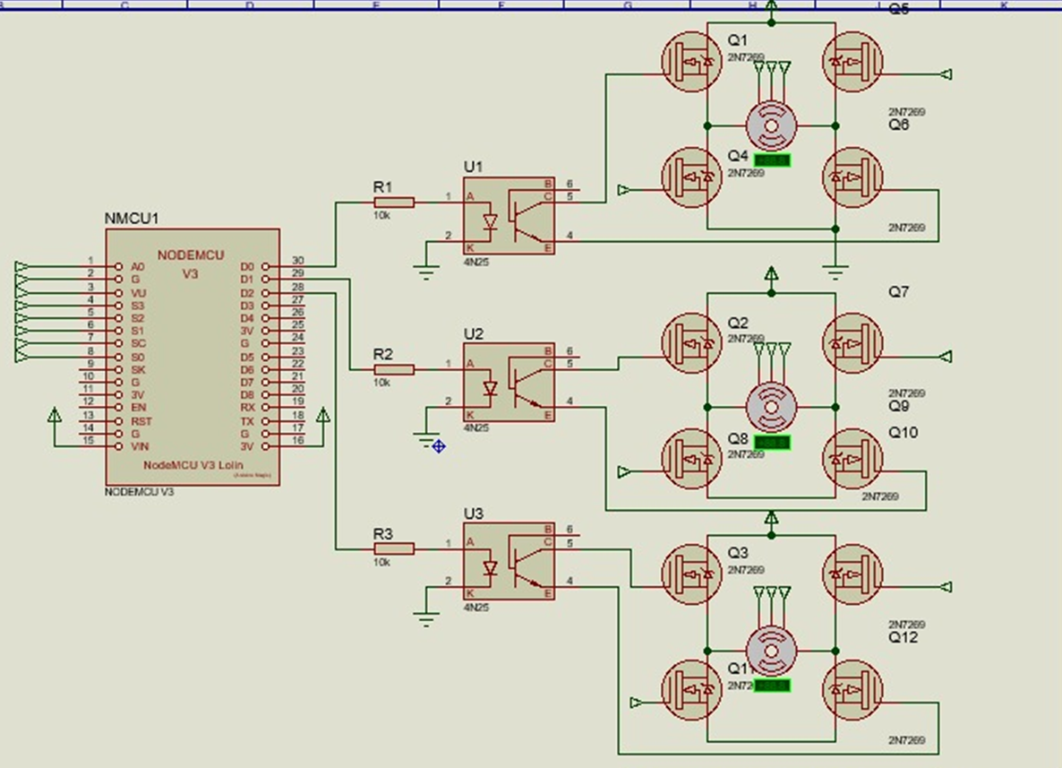
5. Electronic design
Figure 8. Electronic design

Slide 8
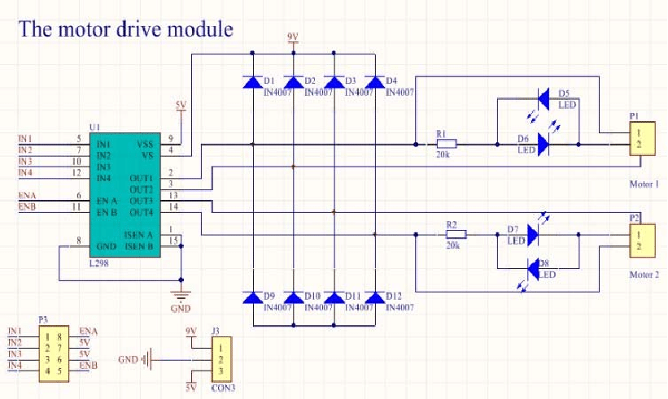
5. Electronic design
Figure 9. Schematic L298N

Slide 9
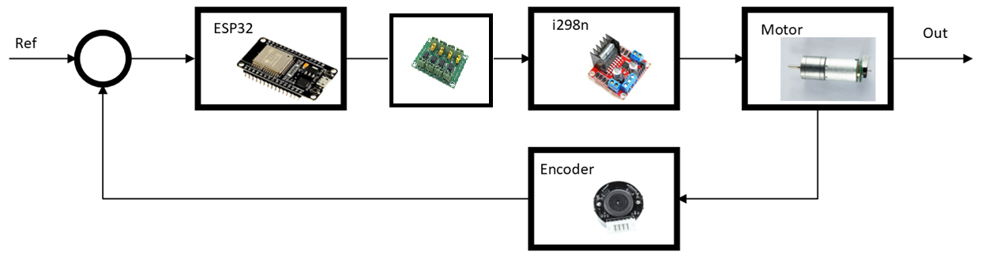
6. Control design
Figure 10. Control diagram

Slide 10
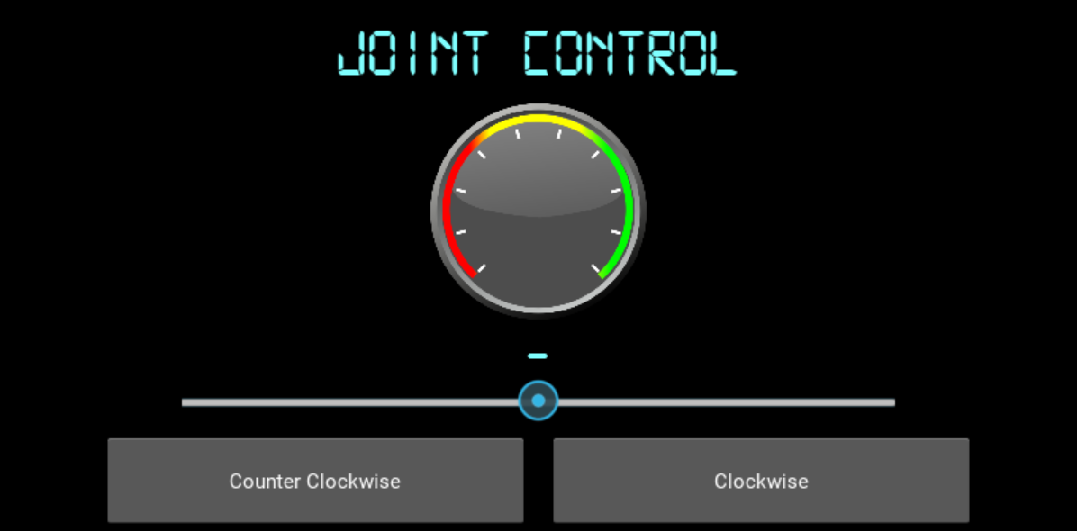
6. Control design
Figure 11. Interface

Slide 11
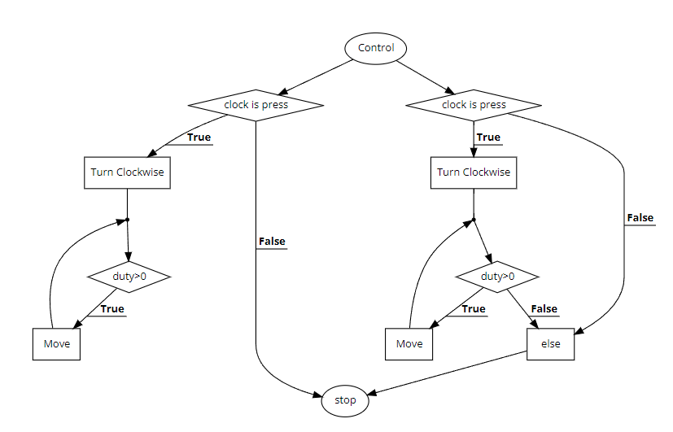
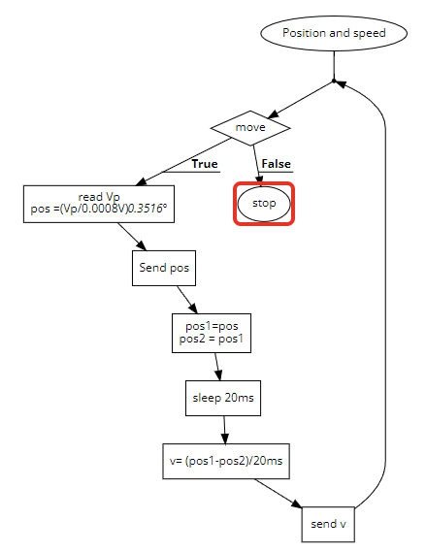
6. Control design
Figure 12. Control diagram
Figure 13. Position and speed

Slide 12
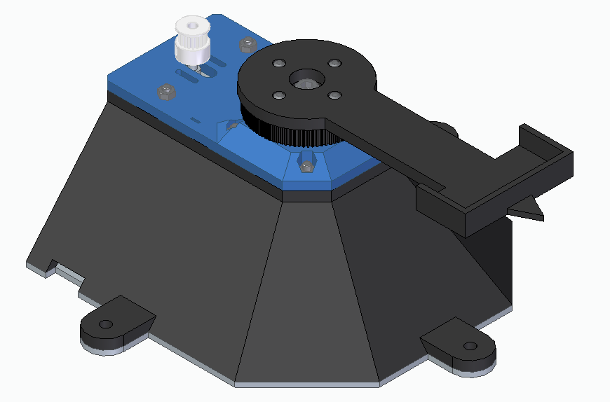
7. Mechanic design
Figure 14. Mechanical system

Slide 13
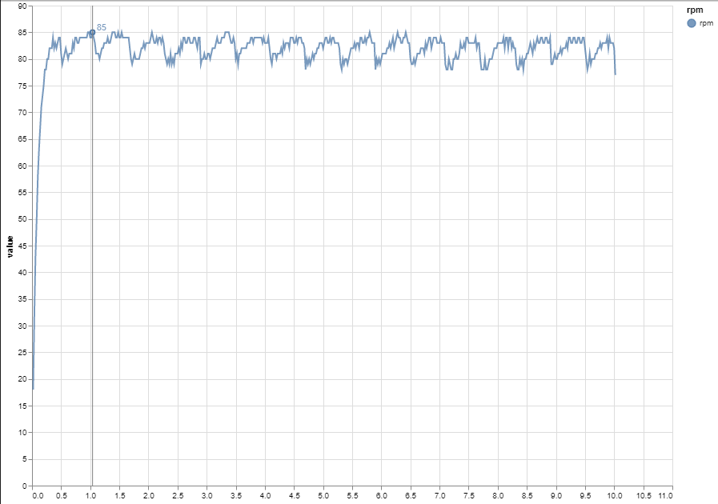
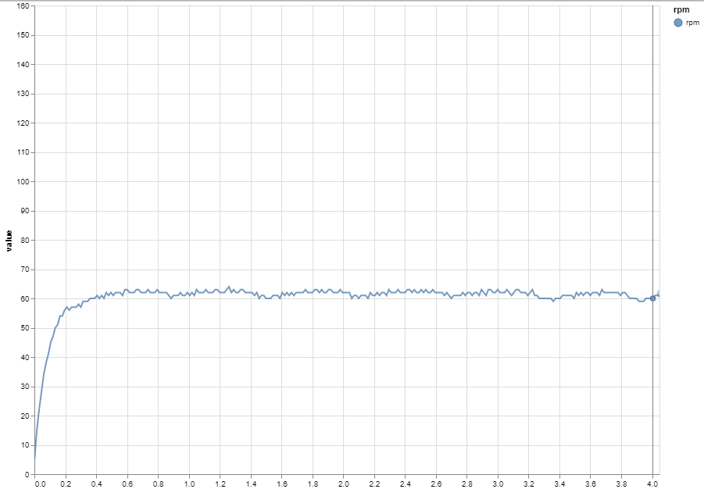
8. Data acquisition
Figure 15. RPM vs time graphs (20ms)
Figure 16. RPM vs time graphs (15ms)

Slide 14
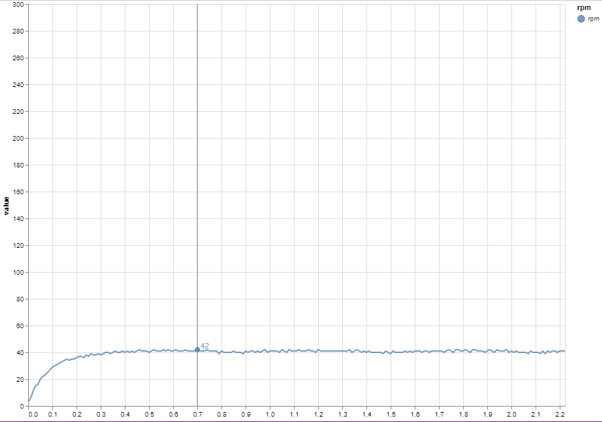
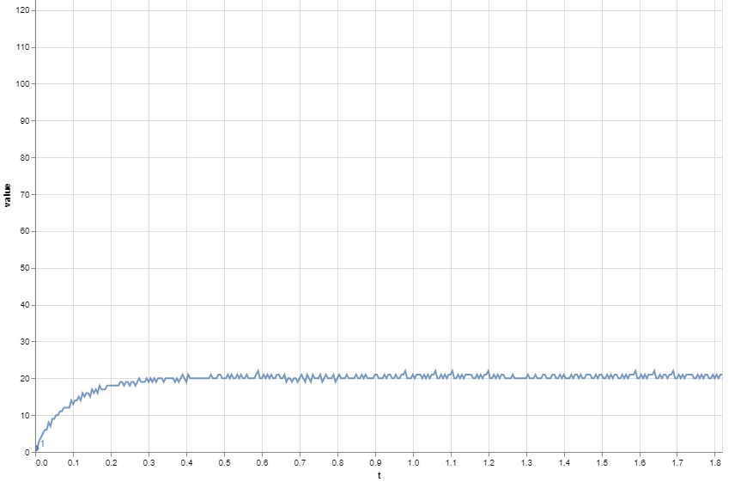
8. Data acquisition
Figure 17. RPM vs time graphs (10ms)
Figure 18. RPM vs time graphs (5ms)

Slide 15
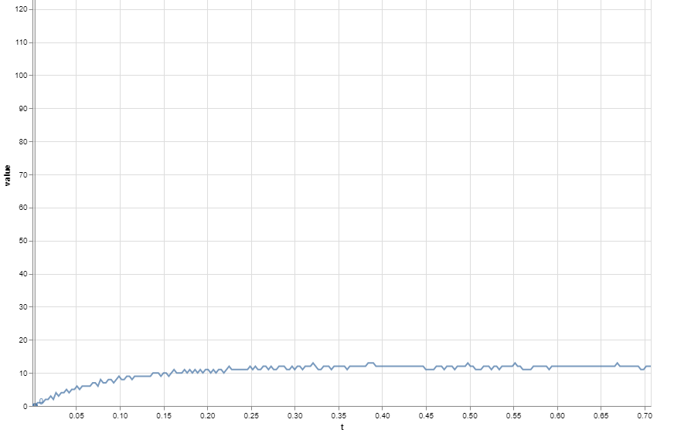
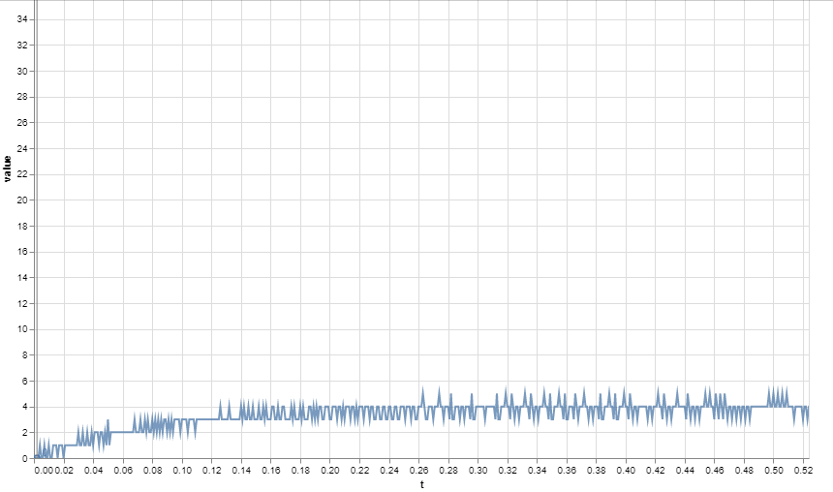
8. Data acquisition
Figure 19. RPM vs time graphs (3ms)
Figure 18. RPM vs time graphs (1ms)

Slide 16
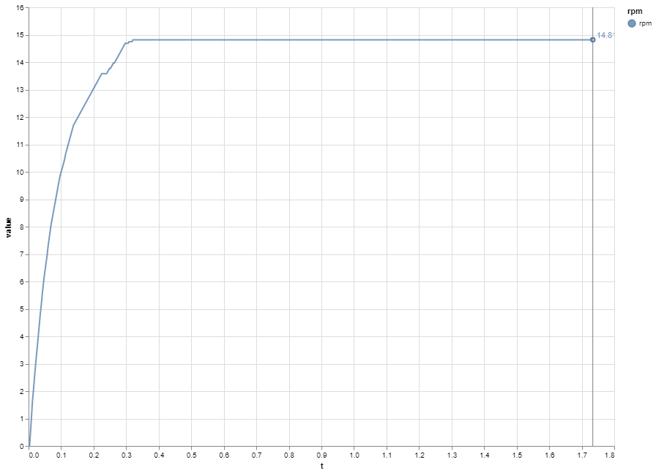
8. Data acquisition
Figure 20. RPM vs time graphs, smooth (3ms)

Slide 17
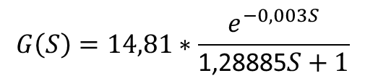
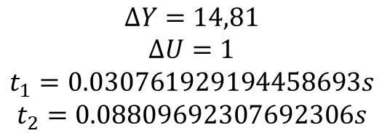

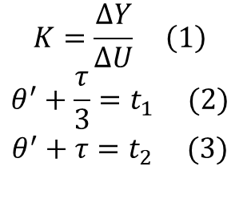
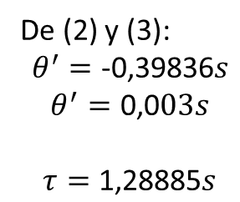
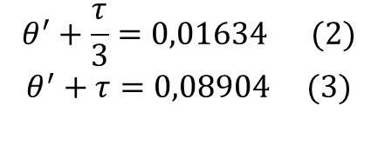
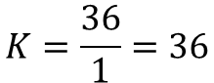
8. POR system
$$K=\frac{∆Y}{∆U} \left(1\right)$$
$$θ^{′}+\frac{τ}{3}=t_{1} (2)$$
$$θ^{′}+τ=t_{2} (3)$$
$$θ^{′}+\frac{τ}{3}=0,01634 (2)$$
$$θ^{′}+τ=0,08904 (3)$$
De (2) y (3):
$$θ^{′}=\text{-0}\text{,}\text{39836}s$$
$$θ^{′}=\text{0}\text{,0}03s$$
$$τ=\text{1}\text{,}\text{28885}s$$
$$K=\frac{36}{1}=36$$
$$∆Y=14,81$$
$$∆U=1$$
$$t_{1}=0.030761929194458693s$$
$$t_{2}=0.08809692307692306s$$
$$G\left(s\right)=\frac{Y\left(S\right)}{U\left(S\right)}=K∗\frac{e^{−θ^{′}S}}{τS+1}=14,81∗\frac{e^{−0,003S}}{\text{1}\text{,}\text{28885}S+1}$$
$$G\left(S\right)=14,81∗\frac{e^{−0,003S}}{\text{1}\text{,}\text{28885}S+1}$$

Slide 18
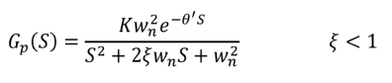
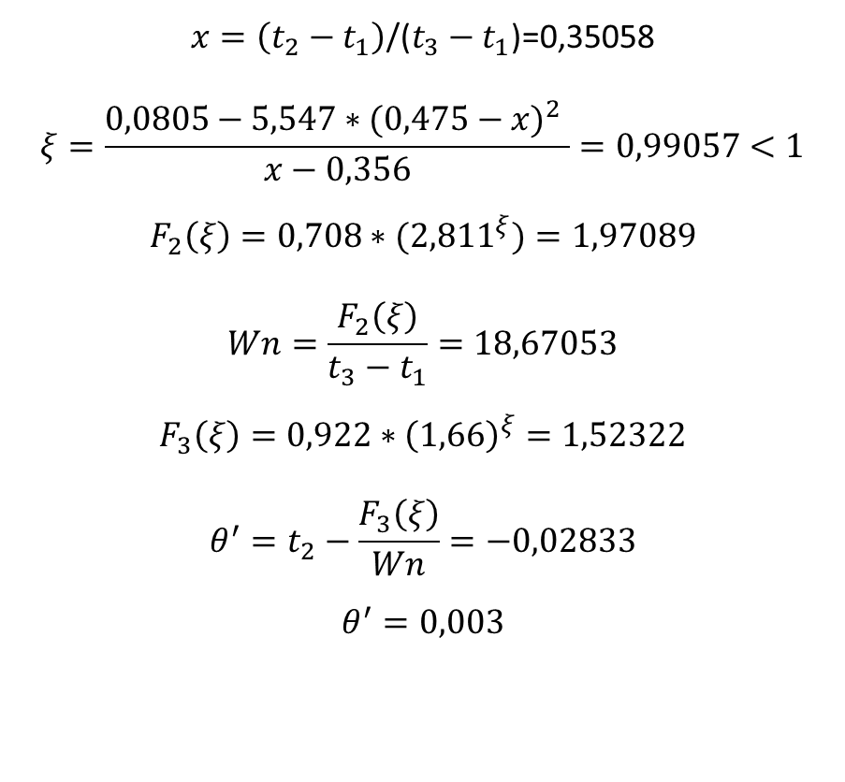
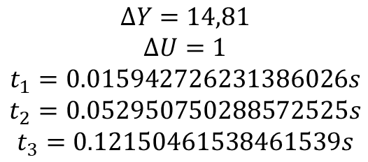
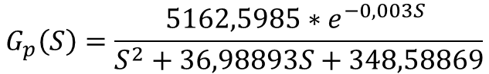
9. SOR system
$$x=\left(t_{2}−t_{1}\right)\text{/(}t_{3}−t_{1}\text{)}\text{=}\text{0,35058}$$
$$ξ=\frac{0,0805−5,547{∗(0,475−x)}^{2} }{x−0,356}=0,99057<1$$
$$F_{2}\left(ξ\right)=0,708∗({2,811}^{ξ})=1,97089$$
$$Wn=\frac{F_{2}\left(ξ\right)}{t_{3}−t_{1}}=18,67053$$
$$F_{3}\left(ξ\right)=0,922∗{\left(1,66\right)}^{ξ}=1,52322$$
$$θ^{′}=t_{2}−\frac{F_{3}\left(ξ\right)}{Wn}=−0,02833$$
$$θ^{′}=0,003$$
$$∆Y=14,81$$
$$∆U=1$$
$$t_{1}=0.015942726231386026s$$
$$t_{2}=0.052950750288572525s$$
$$t_{3}=0.12150461538461539s$$
$$G_{p}\left(S\right)=\frac{5162,5985∗e^{−0,003S} }{S^{2}+36,98893S+348,58869}$$

Slide 19
References
https://www.sigmaelectronica.net/producto/esp-32/
https://components101.com/modules/l293n-motor-driver-module
https://www.didacticaselectronicas.com/index.php/elementos-electromecanicos/motores-y-solenoides-1/motores-dc-1/con-encoder/motorreductor-con-encoder-150-rpm-9-5kg-cm-gearmotor-de-25mm-para-robot-9vdc-mdc-enco-150r-9-5kg-motores-motorreductores-motoreductores-motor-reductores-dc-con-encoder-150rpm-detail
https://www.vistronica.com/robotica/motores/motorreductores/motorreductor-con-encoder-160-rpm-1-95-kg-cm-1-74-8-detail.html
https://grabcad.com/library
http://tecbolivia.com/index.php/venta-de-componentes-electronicos-11/actuadores/motor-dc-gm25-370-150rpm,-9v-para-carro-robot-detail

